Slide 1
Android
Instructor: Zonghua Gu

Slide 2
Overview

Slide 3
Android
A S/W stack for mobile devices developed and managed by OHA
A free S/W under Apache License
Android
Key Applications
Middleware
Operating System (Linux Kernel 2.6)
Notes:
2

Slide 4
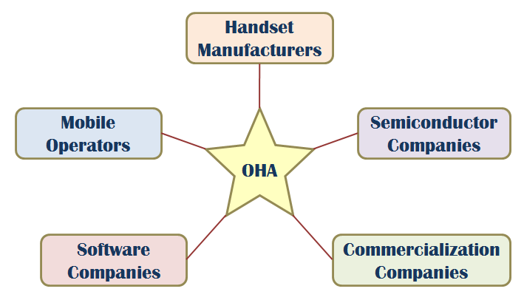
OHA (Open Handset Alliance)
A business alliance consisting of 47 companies to develop open standards for mobile devices

Slide 5
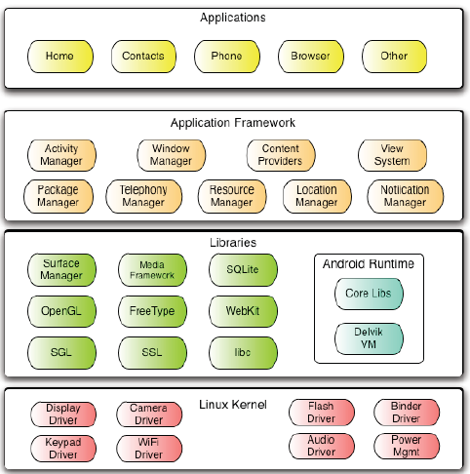
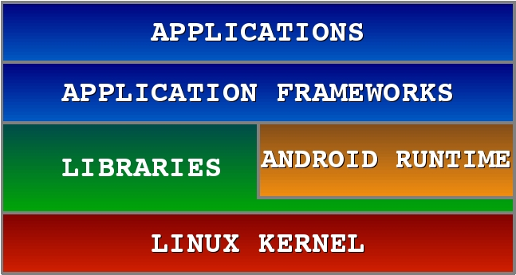
Android Software Stack

Slide 6
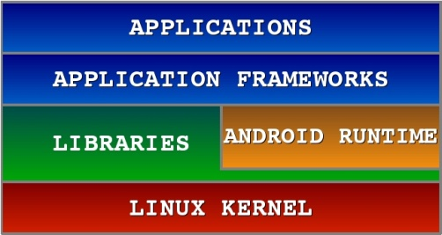
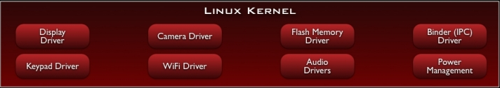
Android S/W Stack – Linux Kernel
Relying on Linux Kernel 2.6 for core system services
Memory and Process Management
Network Stack
Driver Model
Security
Providing an abstraction layer between the H/W and the rest of the S/W stack

Slide 7
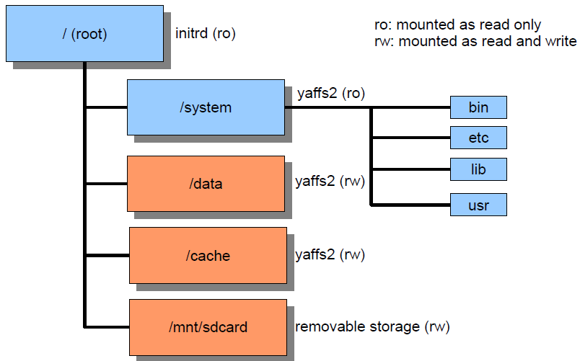
Directory Structure

Slide 8
Android S/W Stack – Linux Kernel (Cont)
Kernel Enhancements
Alarm
Kernel Debugger
Ashmem
Binder for IPC
Wakelock for Power Management
Low Memory Killer
Logger

Slide 9
Ashmem
Android / Anonymous SHared MEMory subsystem
$(TOP)/system/core/cutils/ashmem.h
int ashmem_create_region(const char *name, size_t size)→returns fd
int ashmem_set_prot_region(int fd, int prot)
int ashmem_pin_region(int fd, size_t offset, size_t len)
int ashmem_unpin_region(int fd, size_t offset, size_t len)
Kernel reclaims not ‘pin’ ed memory
Similar to weak reference of Java. Useful for implementing cache.
Accessed as android.os.MemoryFile from Java program

Slide 10
Binder
Binder
Driver to facilitate IPC between applications and services
Problems of Linux IPC
Applications and Services may run in separate processes but must communicate and share data
IPC can introduce significant processing overhead and security hole
Properties of Binder
High performance IPC through shared memory
Per-process thread pool for processing requests
Reference counting and mapping of object references across processes
Synchronous IPC calls between processes
A special device driver /dev/binder

Slide 11
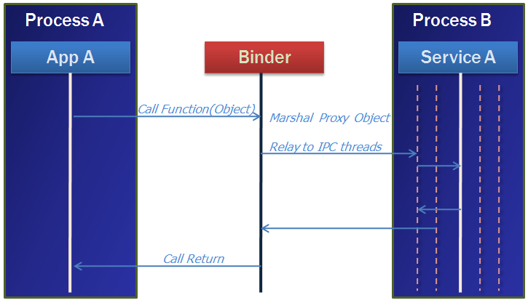
Binder (Cont)
A pool of threads is associated to each service application to process incoming IPC.
Binder performs mapping of object between two processes.
Binder uses an object reference as an address in a process’s memory space.

Slide 12
Low Memory Killer
Upon detecting memory shortage, the kernel can select a process with low priority and kills it.
It's OK. because specification in the Android component life cycle states that each application component is responsible for preserving its own state

Slide 13
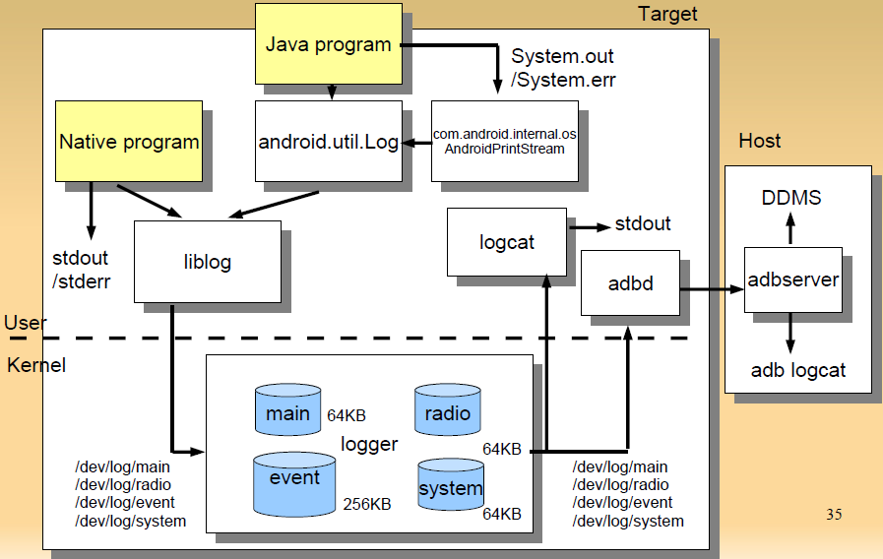
Logger

Slide 14
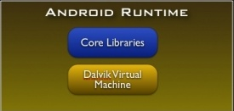
Android S/W Stack - Runtime
Core Libraries
Providing most of the functionality available in the core libraries of the Java language
APIs
Data Structures
Utilities
File Access
Network Access
Graphics
Etc

Slide 15
Android S/W Stack – Dalvik
Dalvik Virtual Machine
Providing environment on which every Android application runs
Each Android application runs in its own process, with its own instance of the Dalvik VM
Compared to JVM:
Android Java = Java SE – AWT/Swing + Android API
16-bit, register-based (vs. 8-bit, stack-based JVM)
Runs .dex files (vs. byte-code in JVM)
More efficient and compact implementation (so that a device can run multiple VMs efficiently）
Different set of Java libraries than Java SDK
Has JIT (Just-In-Time) compilation & concurrent Garbage collection (similar to JVM)

Slide 16
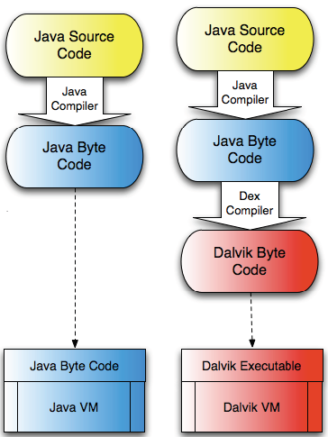
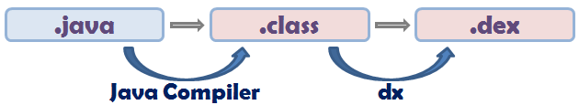
Android S/W Stack – Dalvik
Dalvik Virtual Machine
Executes the Dalvik Executable (.dex) format
.dex format is optimized for minimal memory footprint.
Compilation
Relies on Linux Kernel for:
Threading
Low-level memory management

Slide 17
Example Source code
public class Demo {
public static void foo() {
int a = 1;
int b = 2;
int c = (a + b) * 5;
}
}

Slide 18
Java Byte Code
0: iconst_1
1: istore_0
2: iconst_2
3: istore_1
4: iload_0
5: iload_1
6: iadd
7: iconst_5
8: imul
9: istore_2
10: return
10 bytes
9 reads
10 writes

Slide 19
Android Bytecode
0000: const/4 v0, #int 1 // #1
0001: const/4 v1, #int 2 // #2
0002: add-int/2addr v0, v1
0003: mul-int/lit8 v0, v0, #int 5 // #05
0005: return-void
5 bytes
4 reads
4 writes

Slide 20
File Size Comparison
Contents | Uncompressed jar File |  | Compressed jar File |  | Uncompressed dex File
 | In Bytes | In % | In Bytes | In % | In Bytes | In %
Common System Libraries | 21445320 | 100 | 10662048 | 50 | 10311972 | 48
Web browser Application | 470312 | 100 | 232065 | 49 | 209248 | 44
Alarm check Application | 119200 | 100 | 61658 | 52 | 53020 | 44

Slide 21
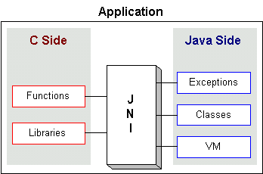
JNI: Java Native Interface
Java interface to non-Java code. It is Java's link to the "outside world"
Native methods are compiled into a dynamic link library (.dll, .so, etc.)
OS loads and links the library into the process that is running the Java Virtual Machine
Part of the Java Developer Kit(JDK), serves as a glue between java side and native side of an application
Allows Java code that runs inside a Java Virtual Machine (JVM) to interoperate with applications and libraries written in other programming languages, such as C, C++, and assembly

Slide 22
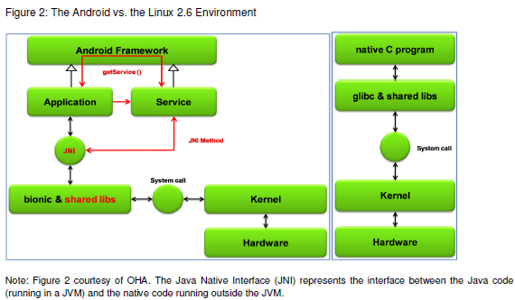
Android vs. Linux

Slide 23
Android Libraries

Slide 24
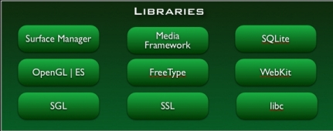
Android S/W Stack - Libraries
Including a set of C/C++ libraries used by components of the Android system
Exposed to developers through the Android application framework

Slide 25
Android S/W Stack – Libraries (Cont)
Features
System C Library (Bionic)
Media Libraries
Surface Manager (Surface Flinger)
Audio Manager (Audio Flinger)
LibWebCore (WebKit)
SGL
3D Libraries
FreeType
SQLite

Slide 26
Android S/W Stack – Libraries (Cont)
Bionic
Custom libc implementation optimized for embedded use
Problem with GNU libc
License | The authors want to keep GPL out of user-space.
Size | Libc will load in each process, so it needs to be small.
Speed | Limited CPU power means it needs to be fast.

Slide 27
Android S/W Stack – Libraries (Cont)
Bionic (Cont)
Properties
BSD license
Small size and fast code paths
Very fast and small custom pthread implementation
No support for certain POSIX features
No compatibility with GNU libc
All native code must be compiled with bionic

Slide 28
Android S/W Stack – Libraries (Cont)
WebKit
An application framework that provides foundation for building a web browser based on open source WebKit browser
Properties
Ability to render pages in full (desktop) view
Full CSS, JavaScript, DOM, AJAX support
Support for single-column and adaptive view rendering

Slide 29
Android S/W Stack – Libraries (Cont)
Media Framework
A media framework based on PacketVideo OpenCore platform
Properties
Support for standard video, audio, still-frame formats
Support for hardware/software codec plug-ins
SQLite
Light-weight relational database management system
Back end for most platform data storgae

Slide 30
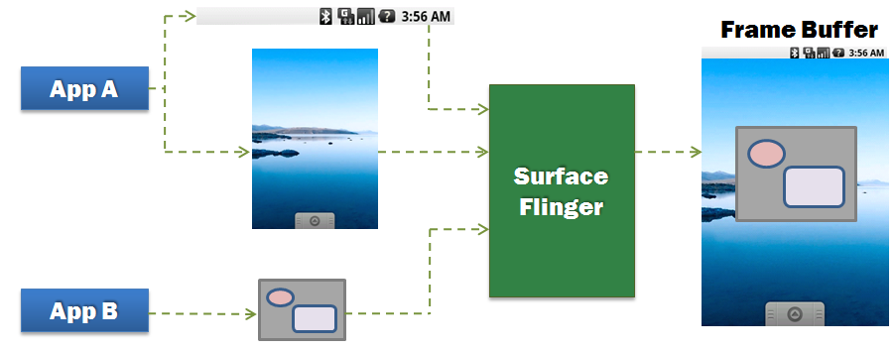
Android S/W Stack – Libraries (Cont)
Surface Manager (Surface Flinger)
Providing system-wide surface composer, handling all surface rendering to frame buffer device
Operation

Slide 31
Android S/W Stack – Libraries (Cont)
Surface Manager (Cont)
Properties
Can combine 2D and 3D surfaces and surfaces from multiple applications
Surfaces passed as buffers via Binder IPC calls
Can use OpenGL ES and 2D hardware accelerator for its compositions
Double-buffering using page-flip

Slide 32
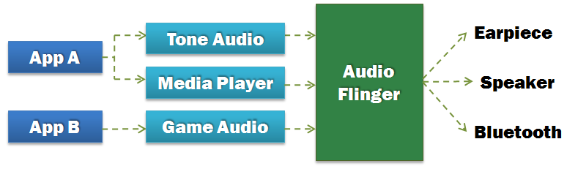
Android S/W Stack – Libraries (Cont)
Audio Manager (Audio Flinger)
Processing multiple audio streams into PCM audio out paths
Operation

Slide 33
Android S/W Stack – Libraries (Cont)
SGL
The underlying 2D graphics engine
3D Libraries
An implementation based on OpenGL ES 1.0 APIs
Using either H/W 3D acceleration (if available) or the included optimized 3D S/W rasterizer
FreeType
Rendering bitmap and vector font

Slide 34
Android Application Framework

Slide 35
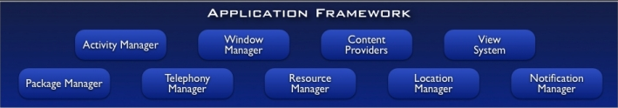
Android S/W Stack – App Framework
Enabling and simplifying the reuse of components
Developers have full access to the same framework APIs used by the core applications.
Users are allowed to replace components.

Slide 36
Android S/W Stack – App Framework (Cont)
Features
Feature | Role
View System | Used to build an application, including lists, grids, text boxes, buttons, and embedded web browser
Content Provider | Enabling applications to access data from other applications or to share their own data
Resource Manager | Providing access to non-code resources (localized string , graphics, and layout files)
Notification Manager | Enabling all applications to display customer alerts in the status bar
Activity Manager | Managing the lifecycle of applications and providing a common navigation backstack

Slide 37

Android S/W Stack - Application
Android provides a set of core applications:
Email Client
SMS Program
Calendar
Maps
Browser
Contacts
Etc
All applications are written using the Java language.

Slide 38
Android Application Package
Android applications are written in Java.
An Android application is bundled by the aapt tool into an Android package (.apk)
.apk
Java Code
Data Files
res/layout: declaration layout files
res/drawable: intended for drawing
res/admin: bitmaps, animations for transitions
res/values: externalized values
strings, colors, styles, etc
res/xml: general XML files used at runtime
res/raw: binary files (e.g. sound)
Resources
Files

Slide 39
Android Component Model
An Android application is packaged in a .apk file.
A .apk file is a collection of components.
Components share a Linux process: by default, one process per .apk file.
.apk files are isolated and communicate with each other via Intents or AIDL.
Every component has a managed lifecycle.
Application (.apk)
Process
Activity
Activity
Activity
Activity
Content Provider
Service
Service

Slide 40
Application Components
Android applications do not have a single entry point (e.g. no main() function).
They have essential components that the system can instantiate and run as needed.
Four basic components
Components | Description
Activity | UI component typically corresponding to one screen
Service | Background process without UI
Broadcast Receiver | Component that responds to broadcast Intents
Content Provider | Component that enables applications to share data

Slide 41
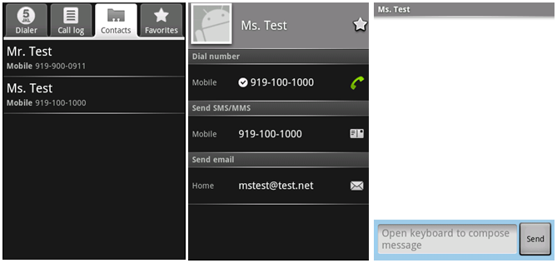
Components - Activity
An activity is usually a single screen:
Implemented as a single class extending Activity.
Displays user interface controls (views).
Reacts on user input/events.
An application typically consists of several screens:
Each screen is implemented by one activity.
Moving to the next screen means starting a new activity.
An activity may return a result to the previous activity.

Slide 42

Components - Activity (Cont)
Typically, one of the activities is marked as the first one that should be presented to the user when the application is launched.
Created “Activity” must be defined into the application’s manifest.

Slide 43
Components - Service
A service does not have a visual user interface, but rather runs in the background for an indefinite period time.
Example: music player, network download, etc
Each service extends the Service base class.
It is possible to bind to a running service and start the service if it's not already running.
While connected, it is possible to communicate with the service through an interface defined in an AIDL (Android Interface Definition Language).
Notification
Service
Communication
Pause/rewind
/stop/restart
Background running
for playback
Media Player
Activity
Binder

Slide 44
Components - Service (Cont)
Adding a "Service" with Android is quite similar than for an "Activity".

Slide 45

Components - Broadcast Receivers
A broadcast receiver is a component that receives and reacts to broadcast announcements (Intents).
Many broadcasts originate in system code.
E.g. announcements that the time zone has changed, that the battery is low, etc.
Broadcast Receiver
Activity
Get incoming calls
Get incoming SMS
SMS

Slide 46
Components - Broadcast Receivers (Cont)
A broadcast receiver is a component that receives and reacts to broadcast announcements.
Applications can also initiate broadcasts.
E.g. to let other applications know that some data has been downloaded to the device and is available for them to use.
All receivers extend the BroadcastReceiver base class.

Slide 47
Components - Content Providers
Application
Activity
Activity
Application
Application
Activity
Content Resolver
Service
Content Resolver
Content Provider
Content Resolver
Data
XML
SQLite
Remote
Store
A content provider makes a specific set of the application's data available to other applications.
The data can be stored in the file system, in an SQLite DB, or in any other manner that makes sense.

Slide 48
Components - Content Providers (Cont)
Using a content provider is the only way to share data between Android applications.
It extends the ContentProvider base class and implements a standard set of methods to allow access to a data store.
Querying
Delete, update, and insert data
Applications do not call these methods directly.
They use a ContentResolver object and call its methods instead.
A ContentResolver can talk to any content provider.
Content is represented by URI and MIME type.

Slide 49
Intents
Intents are simple message objects each of which consists of
Action to be performed (MAIN/VIEW/EDIT/PICK/DELETE/DIAL/etc)
Data to operate on (URI)
startActivity(new Intent(Intent.VIEW_ACTION, Uri.parse("http://www.fhnw.ch"));
startActivity(new Intent(Intent.VIEW_ACTION, Uri.parse("geo:47.480843,8.211293"));
startActivity(new Intent(Intent.EDIT_ACTION,Uri.parse("content://contacts/people/1"));

Slide 50
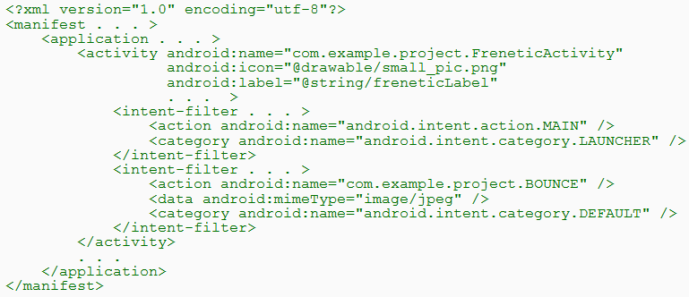
Intents (Cont)
Intent Filters
A component's intent filters in the manifest file inform Android of the kinds of intents the component is able to handle.
An example

Slide 51
Intents (Cont)
Intent Filters (Cont)
An example (Cont)
A component can have any number of intent filters, each one declaring a different set of capabilities.
The first filter in the example indicates that the activity is the entry point for the application.
The second filter declares an action that the activity can perform on a particular type of data.

Slide 52
Processes & Threads

Slide 53
Processes and Threads
Processes
When the first of an application's components needs to be run, Android starts a Linux process for it with a single thread of execution (Main Thread).
Android may decide to kill a process to reclaim resources.
Application (.apk)
1
Process
1
Main Thread

Slide 54
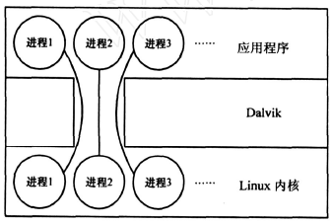
Process Model
One-to-one correspondence between Dalvik applications and Linux kernel processes
Each app runs in its own process
Each process has its own copy of Dalvik VM

Slide 55
Processes and Threads (Cont)
Process (Cont)
We can specify a process where an individual component should run by setting a process name to “process” attribute of <activity>, <service>, <receiver>, or <provider>.
Each component can run in its own process.
Some components share a process while others do not.
Components of different applications also can run in the same process.
We can set a default value that applies to all components by setting a default process to "process” attribute of <application>.

Slide 56
Processes and Threads (Cont)
Threads
Main Thread
All components are instantiated in the main thread of the specified process.
System calls to the components are dispatched from the main thread.
Methods that respond to those calls always run in the main thread of the process.
Components in main thread should not perform long or blocking operations (e.g. network downloads, computation loops)

Slide 57
Processes and Threads (Cont)
Threads (Cont)
Anything that may not be completed quickly should be assigned to a different thread.
Threads are created in code using standard Java Thread objects.
Some convenience classes Android provides for managing threads:
Looper for running a message loop within a thread
Handler for processing messages
HandlerThread for providing a handy way for starting a new thread that has a looper

Slide 58
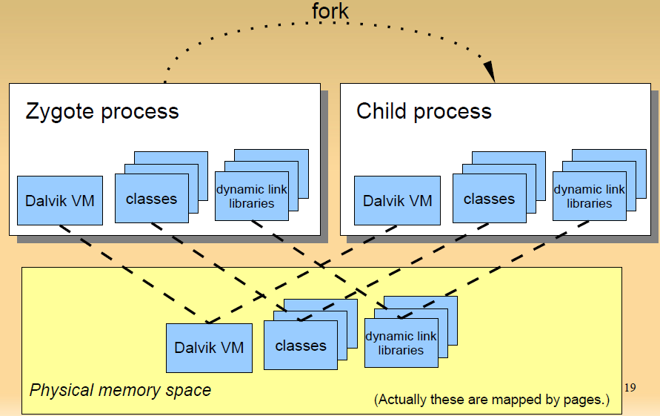
Zygote Process Forks Child Processes

Slide 59
Zygote (Cont)
Zygote process preloads typical (approx. 1800) classes and dynamic link libraries so that child processes start quickly.
Copy-on-write
Only when new process writes page, new page is allocated.
All pages not be written are shared among all zygote children.
Does not use Linux exec() system call

Slide 60
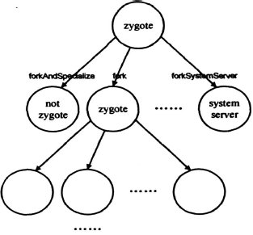
Zygote (Cont)
Only Zygote processes can fork child processes
fork() ,creates a zygote process。
forkAndSpecialize ( ) , creates a non-zygote process。
forkSystemServer ( ) , creates a system server process

Slide 61
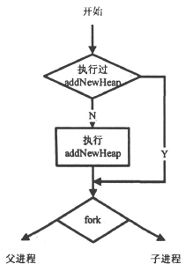
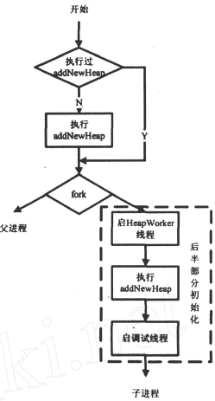
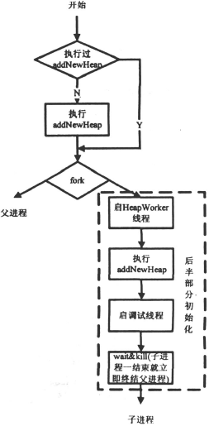
fork()
forkAndSpecialize()
forkSystemServer ( )
Notes:
这三个方法都是本地方法。
先看fork 方法,与另两个本地方法不同的是,fork
方法生成的子进程是一个半初始化的进程,它也是zy2
gote 进程。如果父进程之前已经调用过addNewHeap ,
则不再调用它。这里使用的是写时复制技术,因此zy2
gote 进程是共享同一个堆的。整个初始化到这里就结
束了。
forkAndSpecialize 则不同。首先它创建的子进程
将不再是一个zygote 进程(即离开Zygote 模式,不能
再创建子进程) ,它会启动HeapWorker 线程(一个主要
执行对象的终结函数和引用对象的清理和归队工作的
线程) 和调试线程。其次,它一定会执行addNewHeap
函数,创建一个新的堆,因为一个运行特定任务的进程
不应该和其它进程共享一个堆。
forkSystemServer 和forkAndSpecialize 很相似, 唯
一的不同点是用forkSystemServer 创建的子进程一旦
结束就会立即终止创建它的父进程。
根据Linux 的fork 系统调用可以知道,父子进程
在fork 之后各自堆栈互不相关,但是共享程序正文段
也就是虚拟机核心库代码,dex 文件除外。这样设计
一方面是为了节省内存,另一方面也发挥了Linux 进
程的长处。

Slide 62
UID & GID
UID(user id) and GID(group id) is used for managing multi-user, as in usual Linux system.
Android use this mechanism to isolate applications.
Each application has unique UID.
Can not read/write other application's files.
Zygote runs as UID=0 (root). After forking, each child process’ UID is changed by setuid() system call.

Slide 63
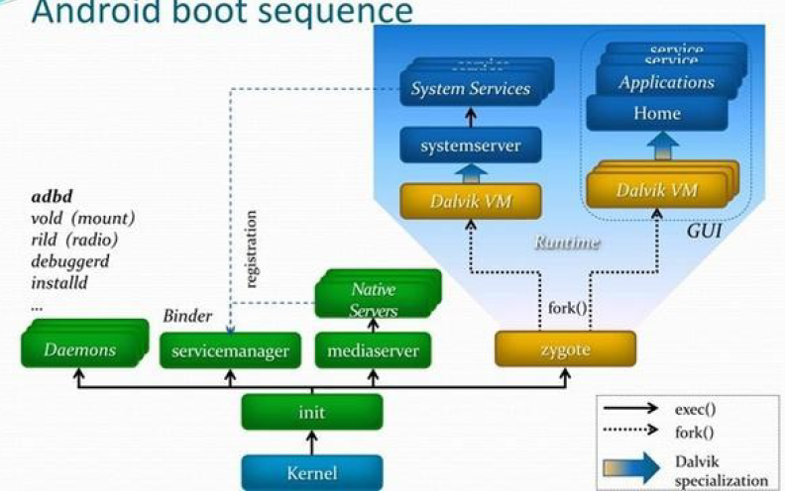
Startup Sequence

Slide 64
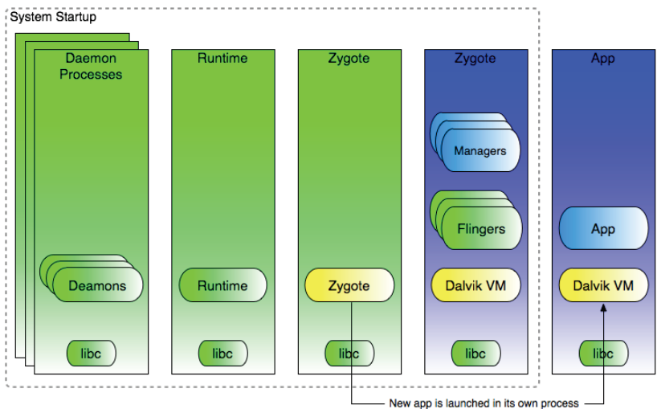
Runtime Processes

Slide 65
Android Power Management

Slide 66
Android Power Management
Problem
Mobile devices depend on battery power and batteries have limited capacity.
Properties of Power Management
PM is built on top of standard Linux Power Management.
PM supports more aggressive power management policy.
Components make requests to keep the power on through “Wake Locks”.
PM supports several different types of wake “Wake Locks”.

Slide 67
Wake Locks
A locked wakelock, depending on its type, prevents the system from entering suspend or other low-power states.
There are two settings for a wakelock:
WAKE_LOCK_SUSPEND: prevents a full system suspend.
WAKE_LOCK_IDLE: prevents low-power states from being entered from idle.
Notes:
, which often cause large interrupt latencies or that disable a set of interrupts, will not be entered
until the wakelocks are released.

Slide 68
Wake Locks (Cont’)
Application holds wakelock on power state
If no wakelocks are held, Android powers down
Ex:
PARTIAL_WAKE_LOCK
CPU on, screen off, keyboard off
SCREEN_DIM_WAKE_LOCK
CPU on, screen dim, keyboard off
SCREEN_BRIGHT_WAKE_LOCK
CPU on, screen bright, keyboard off
FULL_WAKE_LOCK
CPU on, screen on, keyboard bright

Slide 69
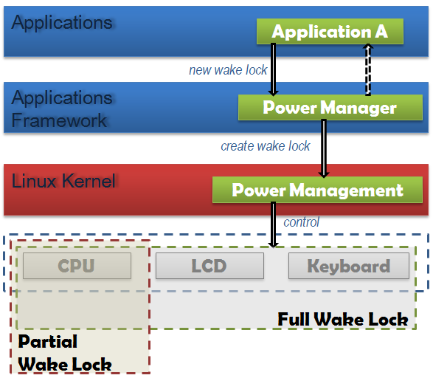
Android Power Management in Action
If there are no active wake locks, CPU will be turned off.
If there are no partial wake locks, screen and keyboard will be turned off.

Slide 70
PM Procedures
All power management calls follow the same basic format:
Acquire handle to the PowerManager service.
Create a wake lock and specify the power management flags for screen, timeout, etc.
Acquire wake lock.
Perform operation (play MP3, open HTML page, etc.).
Release wake lock.

Slide 71
Wakelock Example
PowerManager pm = (PowerManager) GetSystemService (Context.POWER_SERVICE);
PowerManager.WakeLock wl = pm.newWakeLock(PowerManager.SCREEN_DIM_WAKE_LOCK, “tag”);
wl.acquire();
//..screen stays on here
wl.release();
Notes:
PowerManager pm = (PowerManager)mContext.getSystemService( Context.POWER_SERVICE);
PowerManager.WakeLock wl = pm.newWakeLock( PowerManager.SCREEN_DIM_WAKE_LOCK | PowerManager.ON_AFTER_RELEASE, TAG);
wl.acquire();
// ...
wl.release();

Slide 72
Research Paper on PM
Abhinav Pathak, et al,
Where is the energy spent inside my app? Fine Grained Energy Accounting on Smartphones with Eprof, Eurosys 2012
Fine Grained Power Modeling for Smartphones Using System Call Tracing, Eurosys 2011

Slide 73
Main Contributions
Developed fine-grained energy modeling: Predicts fine grained energy consumption using FSM of mobile applications
Implemented on Windows Mobile 6.x and Android
Demonstrated improved accuracy in fine-grained energy estimation over state-of-art utilization based models

Slide 74
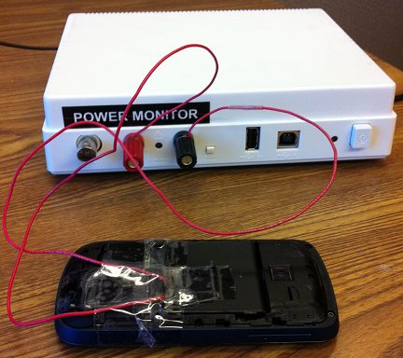
Towards Understanding Energy Drain
Key Question: Where is energy being spent?
Which component/process/thread/function(?)
Approach 1: Use Power Meter
Buy an expensive equipment ($770)
Problems:
Only reports entire device energy consumption
Approach 2 : Develop Online Power Models

Slide 75

Generic Power Modeling
Triggers
Triggers
Actual Power Consumption
Power meter
Predicted Power
Consumption
Training
Phase
Prediction
Phase
Model
Notes:
Make fonts large
Blue color not visible
Put down LR somewhere

Slide 76
Smartphone Power Modeling State-of-Art: Utilization Based (1/2)
Triggers
Utilization
Triggers
Utilization
Actual Power Consumption
Power meter
Predicted Power
Consumption
Training
Phase
Prediction
Phase
Model
Linear Regression (LR) and Superimposition
Model = (Util_{Net})* E_{Net} + (Util_{CPU})* E_{CPU} + (Util_{Disk})* E_{Disk}

Slide 77

Smartphone Power Modeling State-of-Art: Utilization Based (2/2)
Model = (Util_{Net})* E_{Net} + (Util_{CPU})* E_{CPU} + (Util_{Disk})* E_{Disk}
Fundamental (yet intuitive) assumption (Only active) Utilization => power consumption
Second assumption Energy scales linearly with amount of work
Third assumption Components power consumption add linearly
Hard to correlate energy with its consumers: which process/thread/function?
New ‘exotic’ devices do not have quantitative utlization (Ex. Camera/GPS)
Notes:
Opening/closing sockets cost energy
Devices do interact in terms of energy
Energy does not scale linearly
System calls that do not imply utilization can change
power states.Many systems calls that do not imply high utilization
of components can send the components to high or
low power states. This could be due to power optimizations
programmed in device drivers. For example, on windows
mobile, file open, close, create, delete system calls trigger
a power level change in the sdcard device driver; after these
calls the component remains in a high power state for a few
seconds. Figure 1(a) gives the example of file open on the
touch phone. Similarly, a socket close system call immediately
ends the high tail power state of the NIC on windows
mobile touch smartphones, shown in Figure 1(d). Such low
level power optimizations are typically done in the device
drivers and they also break the utilization-power-state correlation
assumption in utilization-based power models.

Slide 78
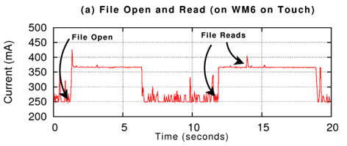
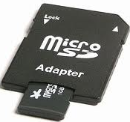
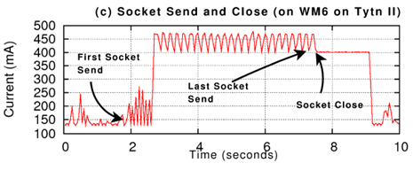
(Only active) Utilization => Power Consumption
File open/delete/ close/create change power state
Several components have tail states (3G, disk, wifi, gps)
(a) Systems calls that do not imply high utilization of components can send the components to high or low power states, due to power optimizations programmed in device drivers.
(c)Device stays at high power state for a period of time after active I/O activities, even when device is idle
Notes:
After socket close at time 8, power consumption for <2 seconds.
System calls that do not imply utilization can change
power states.Many systems calls that do not imply high utilization
of components can send the components to high or
low power states. This could be due to power optimizations
programmed in device drivers. For example, on windows
mobile, file open, close, create, delete system calls trigger
a power level change in the sdcard device driver; after these
calls the component remains in a high power state for a few
seconds. Figure 1(a) gives the example of file open on the
touch phone. Similarly, a socket close system call immediately
ends the high tail power state of the NIC on windows
mobile touch smartphones, shown in Figure 1(d). Such low
level power optimizations are typically done in the device
drivers and they also break the utilization-power-state correlation
assumption in utilization-based power models.

Slide 79
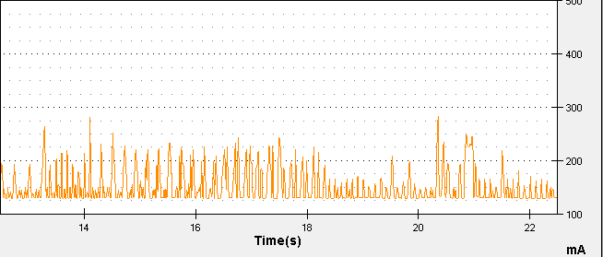
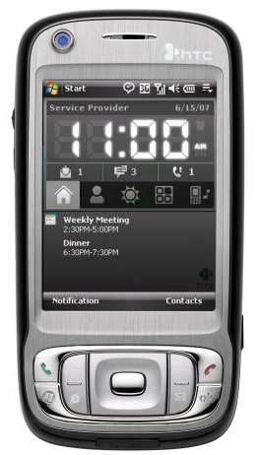
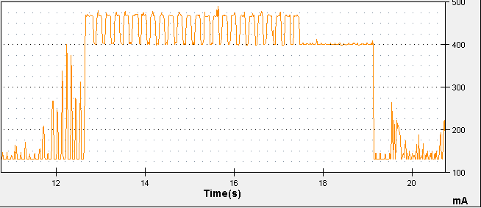
Energy scales linearly with amount of work
(1) Send packets
@ < 50pkts/s
+100-125mA
(2) Send packets
@ > 50pkts/s
+325mA
WM6.5 on Tytn II

Slide 80
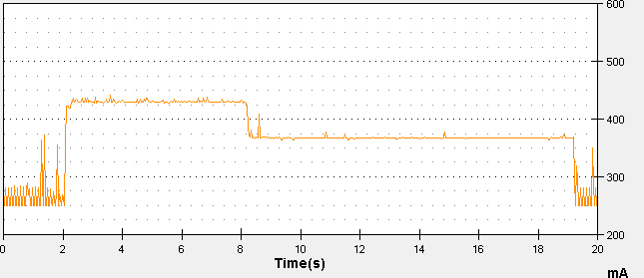
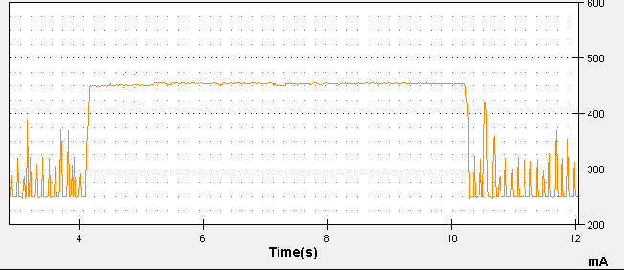
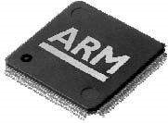
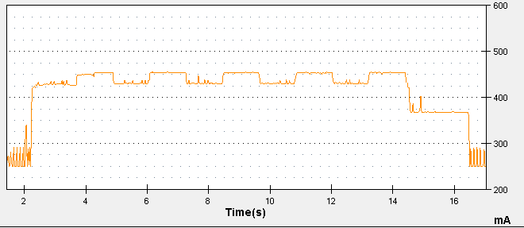
Components power consumption add linearly
WM6.5 on HTC Touch
Send
start
Send done
Spin_CPU
Spin_CPU Stop
Socket close
+200mA
+180mA
+110mA
Send(10mb);
sleep();
Socket.close();
Spin_CPU(2M)
(i = 1)
(2) Spin_CPU(10M);
Send(2mb)
(i = 5)
Spin_cpu(2M)
(i = 5)
Send(2mb)
(i = 1)
(3)
for (i in 1 to 5){
Send(2mb);
Spin_CPU(2M);
}
Sleep();
Socket.close();
+200mA
+110mA
+180mA
Socket close
Network tail
Notes:
Devices do interact in terms of energy
Send 10 mb of data 180mA (2) spin CPU for 10 million cycles 200mA
(3) 180 – 200 – 180 – 200 – When the last CPU spin is over, 110mA.

Slide 81
What have we learnt so far?
Simple (state-of-art) energy modeling assumptions are wrong
There exits a notion of power states
What have we hinted so far?
Device drivers have intelligent power control rules
System calls play a role in power consumption
Challenges in fine-grained power modeling?
Device drivers are closed source (no code/no information)

Slide 82
System Calls As Power Triggers
Key observation: System call is the interface through which an application communicates with the underlying system (hardware) and outside world (Internet, GPS, etc.)
Key Idea: Use System Calls as triggers in power modeling
Advantages:
Encapsulates utilization based triggers
Parameters of system calls
Captures power behavior of ones that do not necessarily imply utilization
Can be traced back to process, thread, function
Eases energy accounting

Slide 83
Finite-State-Machine (FSM) as Power Model Representation
We Use Finite-State-Machine (FSM)
Nodes: Power states
Base State: No activity on phone
Productive state: Actual utilization
Tail state: No-useful work
Edges: Transition rules
System calls (start/completion)
Workload (Ex: 50 pkts/sec)
Timeout
State 1
Transitions
State 2
State 3

Slide 84
FSM Power Model Construction
Systematic ‘Brute Force’ Approach
Step 1 : Model Single System Call
Step 2 : Model Multiple System Calls for Same Component
Step 3 : Model Multiple Components (Entire Phone)
Requires domain knowledge
Semantics of system calls

Slide 85
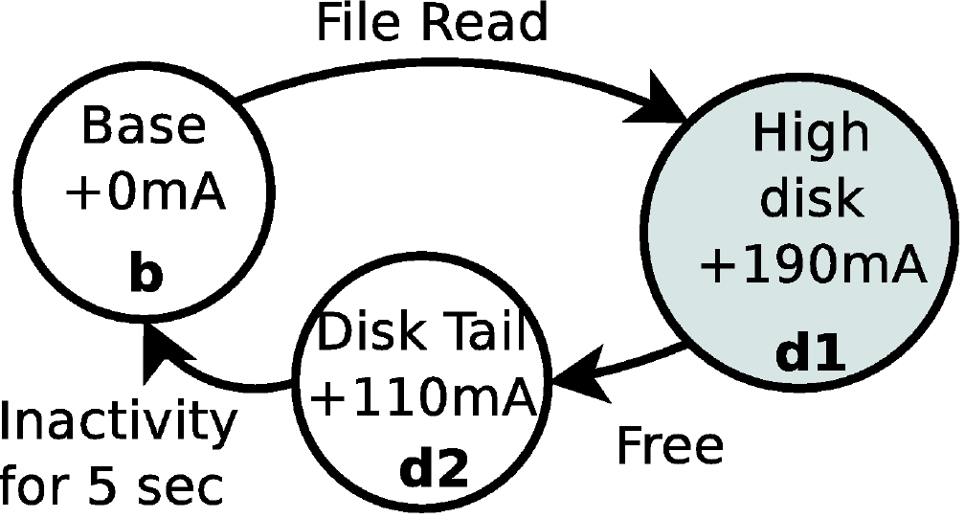
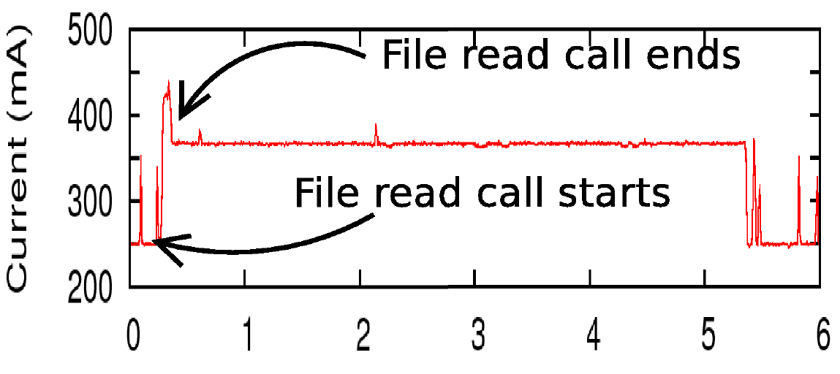

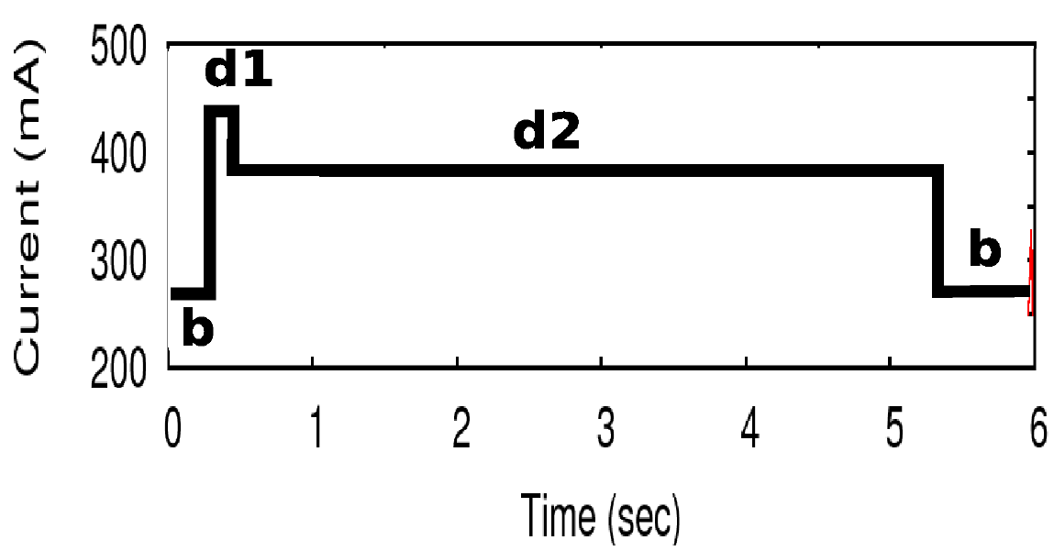
Step 1: Single System Call FSM
WM6.5 on HTC Touch
System call: read (fd, buf, size);
Measured power consumption + system calls (trigger)
Modeled power consumption
FSM

Slide 86
Step 2: Modeling Multiple System Calls of Same Component
Observation: A component can only have a small finite number of power states
Methodology
Identify and merge similar power states
Obey programming order
Model concurrent system calls

Slide 87
Step 2: WiFi NIC
WM6.5 on HTC Tytn II
Send < 50
Pkts/sec
SEND
Base State +0mA
Low Net
+125 mA
Base State +0mA
Socket close
CLOSE
Send done
Send > 50
Pkts/sec
Socket close
Net Tail
+280 mA
High
Net
+325 mA
Net Tail
+280 mA
Send
Send done
Send < 50
Pkts/sec
Base State +0mA
Low Net
+125 mA
Send done
Socket close
Send > 50
Pkts/sec
Socket close
High
Net
+325 mA
Net Tail
+280 mA
Send
Send done

Slide 88
Step 3: Modeling Multiple Components
Observation: Different components may interact with each other’s power consumption
Methodology
Try to reach different combination of states
Construct new states and transitions in FSM

Slide 89


Implementation
Windows Mobile 6.5
Extended CeLog
Android
System Tap: Logs kernel events
Android debugging framework: Custom logging in Dalvik VM

Slide 90
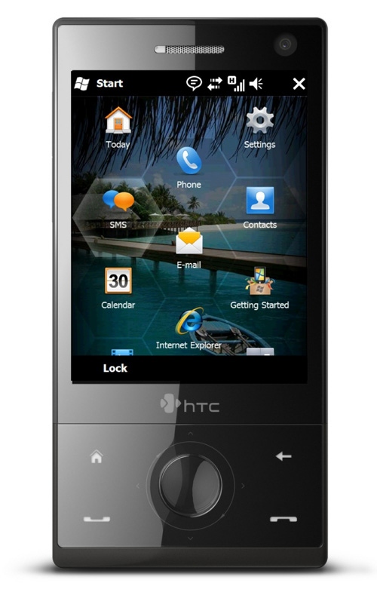
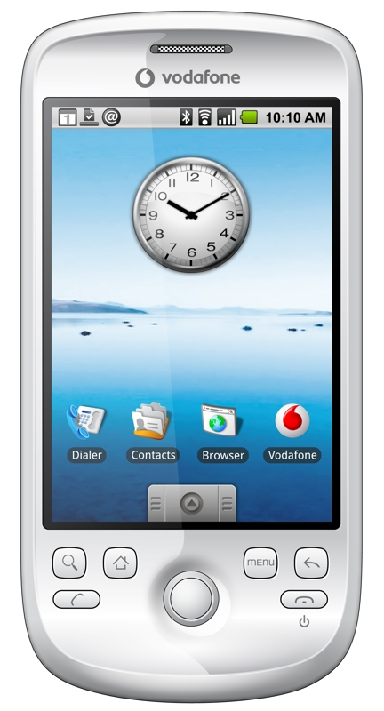
Evaluation: Handsets Used
HTC Tytn II | HTC Touch | HTC Magic
Win 6.5 (CE 5.2) | Win 6.5 (CE 5.2) | Android (Linux 2.6.34)

Slide 91
Snapshot of FSM for Entire Phone
Net Tail + CPU
+300 mA
High CPU
+130
mA
CPU
CPU (ctx_in) ctx_out
WM6.5 on HTC Tytn II
Send < 50
Pkts/sec
Base State +0mA
Low Net
+125 mA
Net Tail
+270 mA
High
Net
+325 mA
Send
Send done
Send > 50
Pkts/sec
Send done
Disk: Read /write/open/close/create/delete
Timeout 1.7s
Timeout 3s
High Disk
+125
mA
Disk Tail
+75
mA
DTail+ CPU
+130
mA
Disk
Call completed
CPU

Slide 92
End-To-End Energy Estimation Error
FSM: under 4%
LR: 1% – 20%
Notes:
Say what are applications

Slide 93
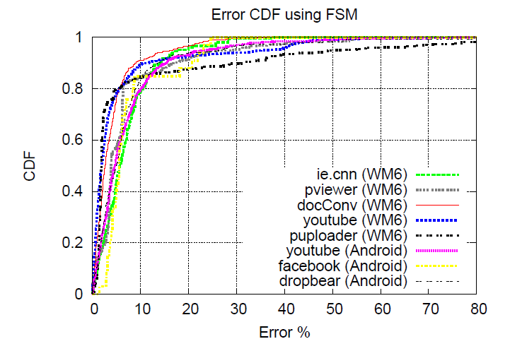
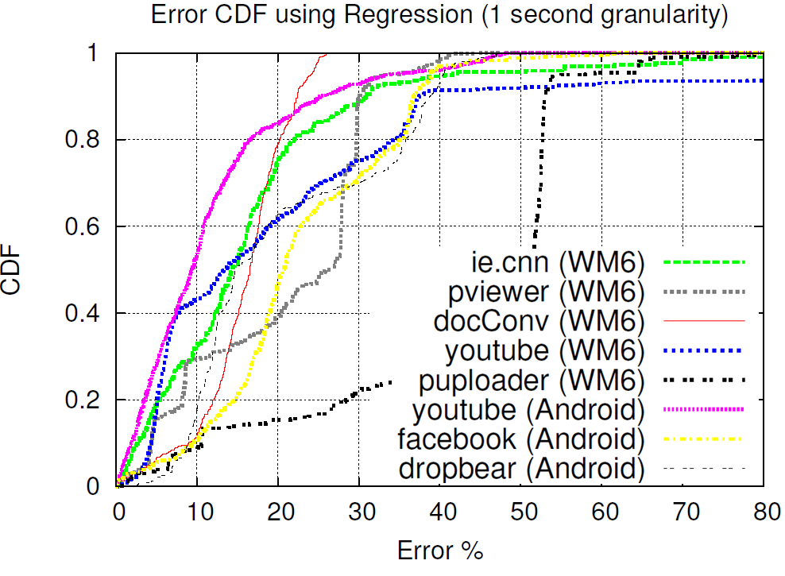
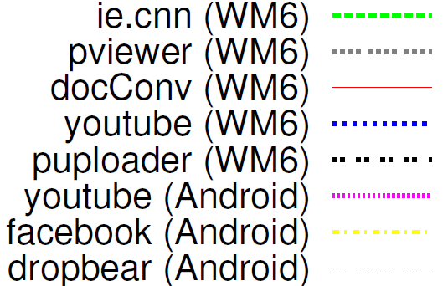
Fine-Grained Energy Estimation
CDF of energy estimation error per 50ms time interval
FSM based on System calls | Linear Regression (State-of-art)
FSM: 80th percentile error less than 10% for all apps
LR: 10th percentile error less than 10% for all apps
Notes:
What to say here
Make fig fonts larger

Slide 94
Paper Contains …
Detailed FSM construction
Handling special cases (CPU Frequency, WiFi Signal Strength)
FSM for 3 smartphones
Detailed Accuracy Results
Why our model performs better than state-of-art
Logging Overhead
Under 10% overhead on both the OSes
Application: Energy Profiler
Call-Graph Energy profiler for smartphone apps
Generates source code heat map

Slide 95
Eprof: Energy Profiler
Problem
Measure per function (thread/process) energy consumption of an application
Challenge
Correct energy accounting (tail energy, component interaction)
Approach:
Build FSM power models
Syscalls can be traced to process/thread
Manual or compiler-assisted marking of function boundaries
Notes:
Use pinning to handle tail side-effects

